Slide 1
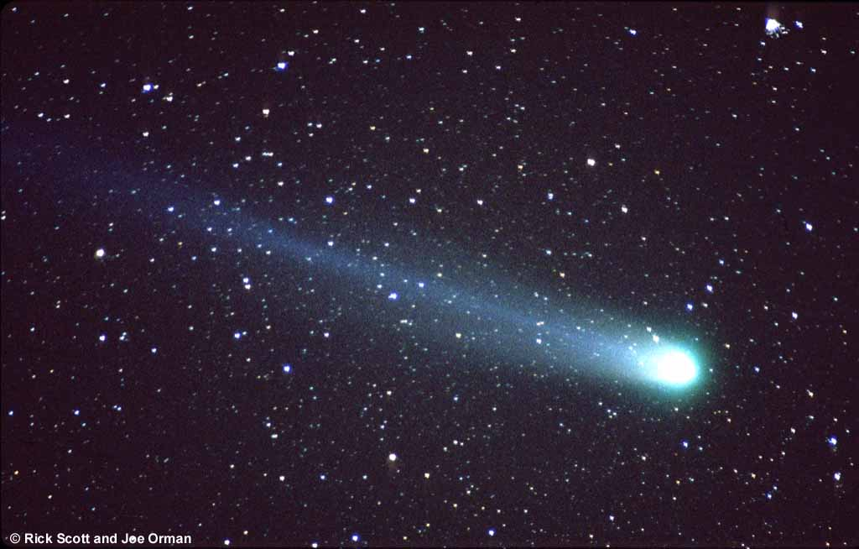
Wanderers in the Night Sky
by
Priya Desai
Stanford University
Notes:
My name is Priya Desai and some of you know me as Aman’s mom. While Aman is at school; I have a different job. I am an astronomer or an astrophysicist.
Do you know what that is?
Well when Aman told me that you were studying about the sun and moon and stars and asked if I could come and give a presentation; I said yes and so here I am.

Slide 2
Wanderers in the Night Sky
But what if you get lost ?
Or caught by an alien?
Notes:
The title is “Wanderers in the night sky”. I have deliberately used the word “wanderers” ..it has a special
Significance and I will give you a hint why during the presentation so lets see how many of you catch it.
Before we start wandering ..we should know our address home..to tell any aliens we may meet or if we get lost.

Slide 3

Where is Home?
Regnart Elementary School
Notes:
Suppose you met an alien and he wanted to know your address?
What would it be?

Slide 4

Regnart Elementary School

Slide 5
Where is Home?
Regnart Elementary School
Cupertino

Slide 6
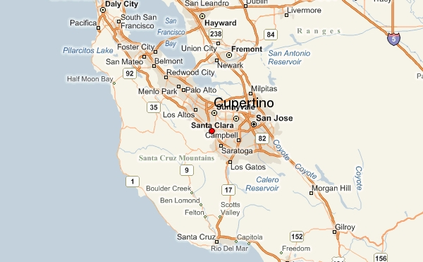
Cupertino

Slide 7
Where is Home?
Regnart Elementary School
Cupertino
Santa Clara County

Slide 8
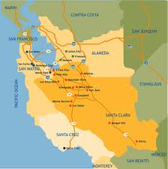
Santa Clara County

Slide 9
Where is Home?
Regnart Elementary School
Cupertino
Santa Clara county
California

Slide 10
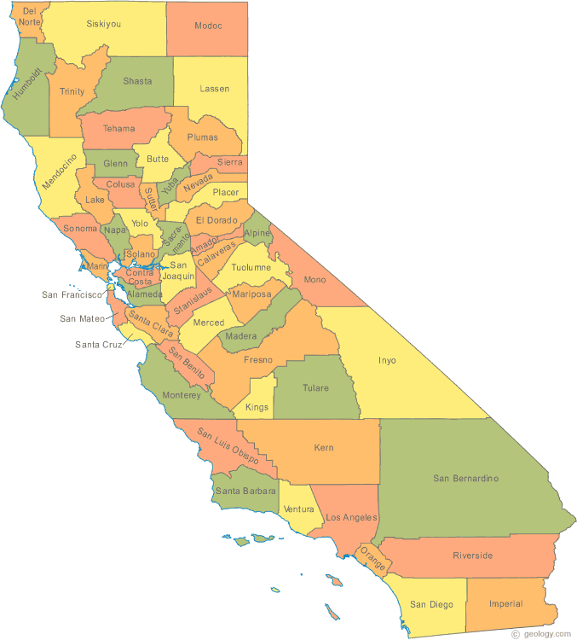
California

Slide 11
Where is Home?
Regnart Elementary School
Cupertino
Santa Clara county
California
United States
Notes:
So suppose you were a space traveller and you had to punch in your home address or coordinates what would they be?
This in general is a popular idea and well received. Cheryl suggests I flip the order ie go from the Milkyway
To- Solar system—to—earth etc instead of the other waya around. I don’t agree.

Slide 12
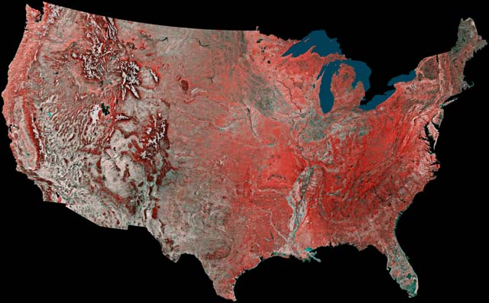
United States of America

Slide 13
Where is Home?
Regnart Elementary School
Cupertino
Santa Clara county
California
United States
North America

Slide 14
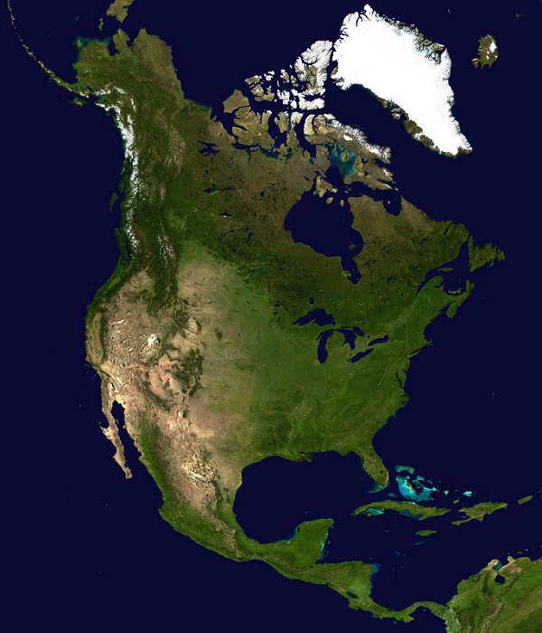
North America

Slide 15
Where is Home?
Regnart Elementary School
Cupertino
Santa Clara county
California
United States
North America
Earth

Slide 16
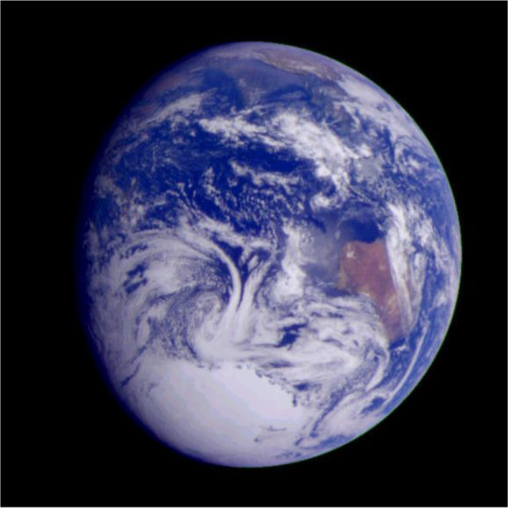
Our Earth

Slide 17
Where is Home?
Regnart Elementary School
Cupertino
Santa Clara county
California
United States
North America
Earth
Solar System
Notes:
So suppose you were a space traveller and you had to punch in your home address or coordinates what would they be?
This in general is a popular idea and well received. Cheryl suggests I flip the order ie go from the Milkyway
To- Solar system—to—earth etc instead of the other waya around. I don’t agree.

Slide 18
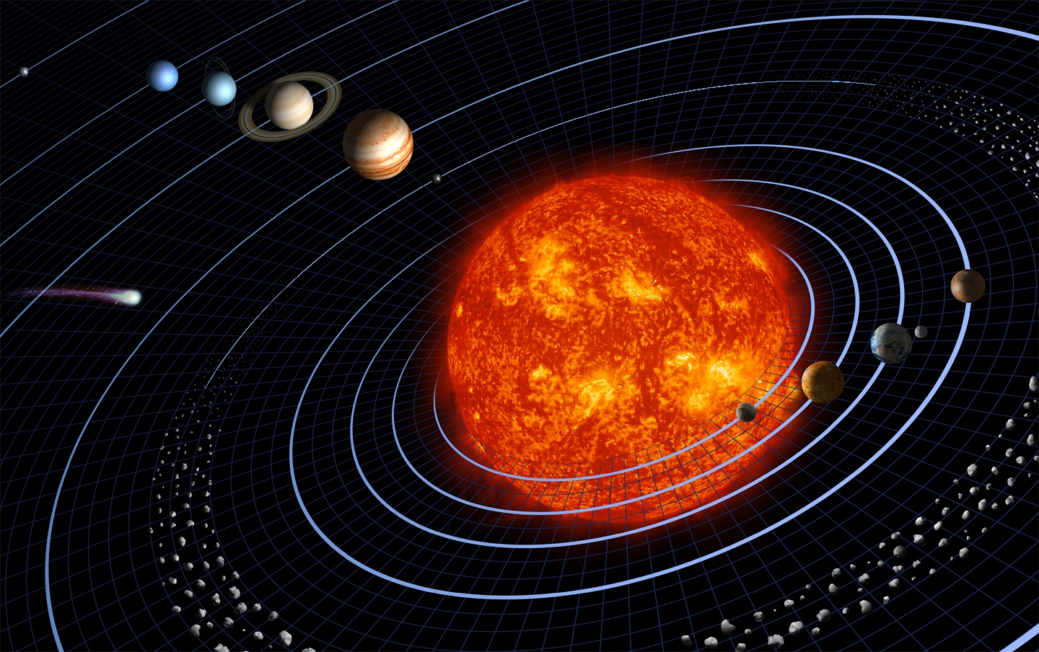
The Solar System
Notes:
The Solar System or solar system^{[1]} is the system comprising the Sun and the retinue of celestial objects gravitationally bound to it: the eight planets, their 162 known moons^{[2]}, three currently identified dwarf planets and their four known moons, and thousands of small bodies. This last category includes asteroids, meteoroids, comets, and interplanetary dust.
The principal component of the Solar System is the Sun or Sol, (astronomical symbol ); a main sequence G2 star that contains 99.86% of the system's known mass and dominates it gravitationally.^{[3]} Because of its large mass, the Sun has an interior density high enough to sustain nuclear fusion, releasing enormous amounts of energy, most of which is radiated into space in the form of electromagnetic radiation, including visible light. The Sun's two largest orbiting bodies, Jupiter and Saturn, account for more than 90% of the system's remaining mass. (The currently hypothetical Oort cloud, should its existence be confirmed, would also hold a substantial percentage).^{[4]}
In broad terms, the charted regions of the Solar System consist of the Sun, four rocky bodies close to it called the terrestrial planets, an inner belt of rocky asteroids, four gas giant planets, and an outer belt of small, icy bodies known as the Kuiper belt. In order of their distances from the Sun, the planets are Mercury ( ), Venus ( ), Earth ( ), Mars ( ), Jupiter ( ), Saturn ( ), Uranus ( ), and Neptune ( ). All planets but two are in turn orbited by natural satellites (usually termed "moons" after Earth's Moon), and every planet past the asteroid belt is encircled by planetary rings of dust and other particles. The planets, with the exception of Earth, are named after gods and goddesses from Greco-Roman mythology.
From 1930 to 2006, Pluto ( ), one of the largest known Kuiper belt objects, was considered the Solar System's ninth planet. However, in 2006 the International Astronomical Union (IAU) created an official definition of the term "planet"^{[5]}. Under this definition, Pluto is reclassified as a dwarf planet, and there are eight planets in the Solar System. In addition to Pluto, the IAU currently recognizes two other dwarf planets: Ceres ( ) , the largest object in the asteroid belt, and Eris (no symbol), which lies beyond the Kuiper belt in a region called the scattered disc. Of the known dwarf planets, only Ceres has no moons.
For many years, the Solar System was the only known example of planets in orbit around a star. The discovery in recent years of many extrasolar planets has led to the term "solar system" being applied generically to all the newly discovered systems. Technically, however, it should strictly refer to Earth's system only, as the word "solar" is derived from the Sun's Latin name, Sol. Other such systems are usually referred to by the names of their parent star; "the Alpha Centauri system" or "the 51 Pegasi system".

Slide 19
Where is Home?
Regnart Elementary School
Cupertino
Santa Clara county
California
United States
North America
Earth
Solar System
Milky Way

Slide 20
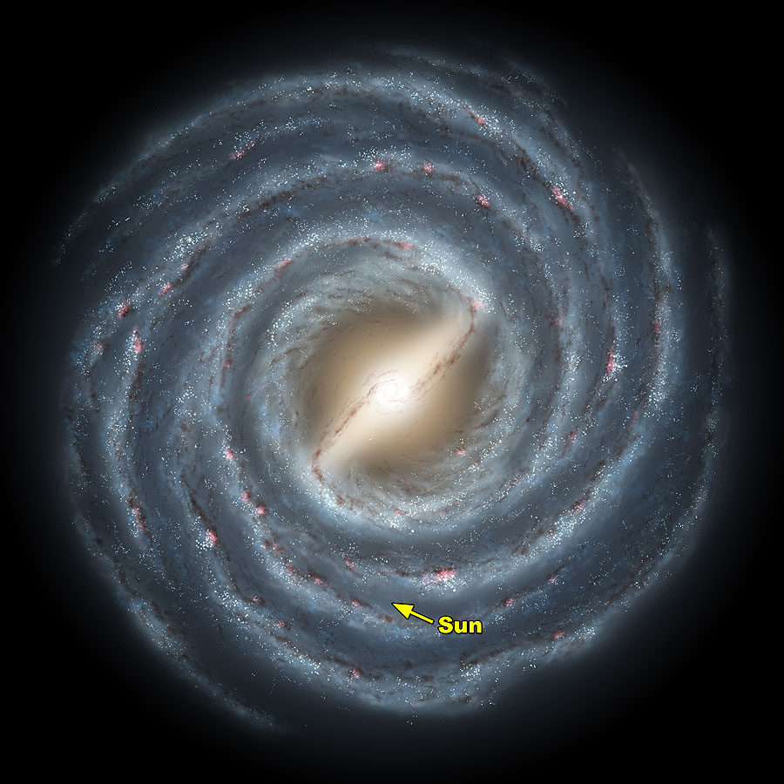
Milky Way
Notes:
Plane of Milkyway : in Infrared taken with COBE. Remember it is re-created. Soalr system is in the Orion arm.

Slide 21
Where is Home?
Regnart Elementary School
Cupertino
Santa Clara county
California
United States
North America
Earth
Solar System
Milky Way
Local group

Slide 22
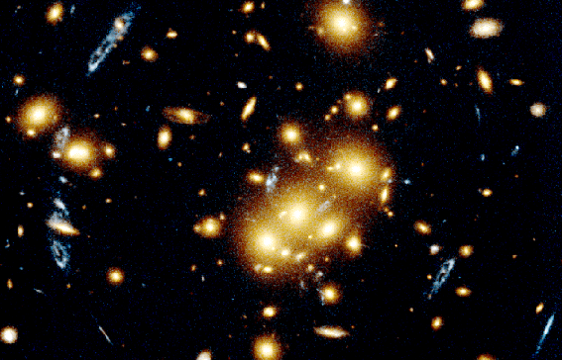
Local group
Local cluster
Notes:
Local group is a cluster of galaxies. Has 54 galaxies covers a 10 mly diameter.

Slide 23
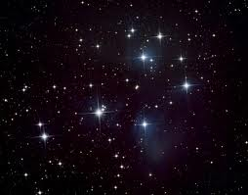
..but what can we see in the night sky?
Stars
Notes:
Stars
planets

Slide 24
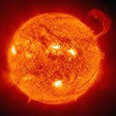
what are STAR’s?
What shape is it??
Why?
Notes:
Stars A star is a massive bodies of hydrogen and helium that gives out its own heat and light.
Closest star to us? Sun
All stars we see belong to the milky way

Slide 25
Which is the star closest to us?
It’s the sun with x-ray goggles
Notes:
Is this what the sun looks like to you?
Sun is 109 times larger than the earth. So 109^3=1 million earths could fit in the sun.

Slide 26
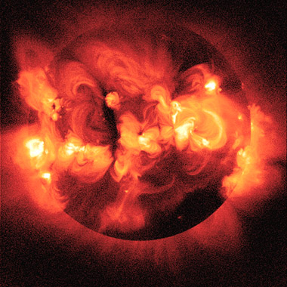
The sun with a different pair of x-ray goggles!
Notes:
Sun is a very violent place: spits out hot gas in the form of flares and
7, suggests taking a really fast racing car while Christopher, age 4, eagerly agrees. Jerry, a really old guy who is used to estimating driving time on family trips based on distance divided by speed, offers to do the numbers. "Let's see ... the Sun is 93 million miles away. So, if we drove 93 miles per hour the trip would only take us 1 million hours." How long is 1 million hours? One year is 365 days times 24 hours per day, or 8,760 hours. One hundred years would be 876,000 hours, still a little short of the 1 million hour drive time -- so the Sun is really quite far away. Christopher is not impressed, but as he grows older he will be. You've got to be impressed by something that's 93 million miles away and still hurts your eyes when you look at it!

Slide 27
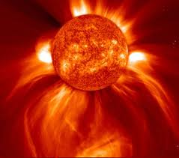
Solar flares
Notes:
Stars
planets

Slide 28
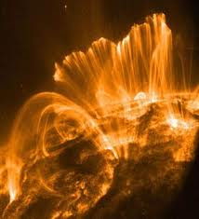
Solar flares close-up
Notes:
Stars
planets

Slide 29
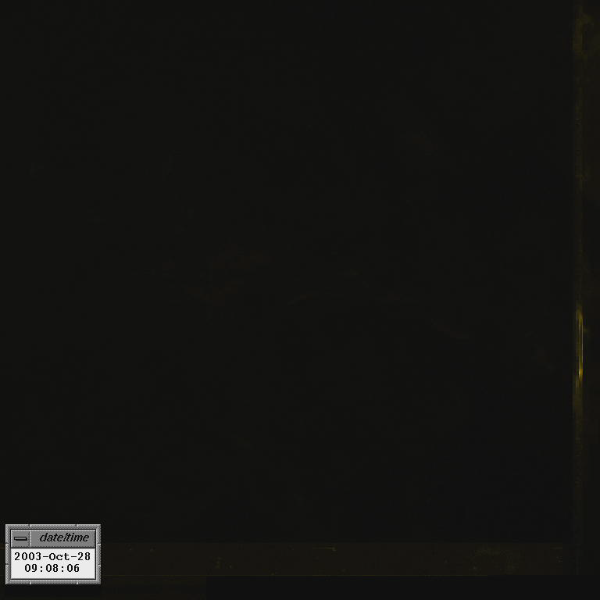
A solar flare

Slide 30
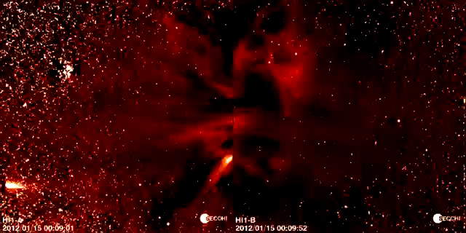

Slide 31
Sun Spot
Notes:
This stunning image shows remarkable and mysterious details near the dark central region of a planet-sized sunspot in one of the sharpest views ever of the surface of the Sun. Just released, the picture was made using the Swedish Solar Telescope now in its first year of operation on the Canary Island of La Palma. Along with features described as hairs and canals are dark cores visible within the bright filaments that extend into the sunspot, representing previously unknown and unexplored solar phenomena. The filaments' newly revealed dark cores are seen to be thousands of kilometers long but only about 100 kilometers wide. Resolving features 100 kilometers wide or less is a milestone in solar astronomy and has been achieved here using sophisticated adaptive optics, digital image stacking, and processing techniques to counter the blurring effect of Earth's atmosphere. At optical wavelengths, these images are sharper than even current space-based solar observatories can produce. Recorded on 15 July 2002, the sunspot shown is the largest of the group of sunspots cataloged as solar active region AR 10030.

Slide 32
But what stars can we see in the night sky?
Notes:
Stars
planets

Slide 33
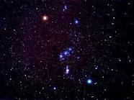
Orion the hunter
Notes:
Stars
planets

Slide 34
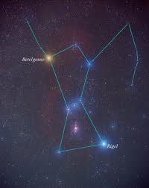
Orion the hunter
Notes:
Stars Orion –hunter: Betelgeuse, Bellatrix seen in the night sky from November to February of each year - late fall to winter in the Northern Hemisphere, In the period May–July (summer in the Northern Hemisphere, winter in the Southern Hemisphere) Orion is in the daytime sky and thus not visible at most latitudes. However for much of Antarctica in the Southern Hemisphere's winter months, the Sun is below the horizon even at midday.
What is the significance of these constellations ?
Calendars .predicted seasons.
12 Comments
Home > Science > Space > Astronomy
Nothing But The Facts About The Constellation Orion
Written by: George Garza • Edited by: RC Davison
Updated Jun 8, 2011 • Related Guides: Greek
The Orion constellation is second only to the constellation of the Big Dipper in recognizability. The constellation was well known to the ancient Greeks with its own hero's and villains and is one of a handful of constellations that are visible from both the northern and southern hemispheres.
Basic Facts About the Constellation Orion
Abbreviation: Ori
Engilish Meaning: the Great Hunter
Right ascension: 5°
Declination: +5°
Area: 594 sq. deg.
Visble Latitudes: between +85° and −75°.
Best Viewing: During January at 21:00 (9 p.m.)
Stars:
Stars in the system: 81
Number of bright stars: 8
Brightest star: Rigel (β Orionis) (0.12m)
Nearest star: GJ 3379 (17.1 light years)
Messier objects: 3
Meteor showers
Orionids - This is a meteor shower that occurs when Earth passes through the dust from Halley's comet. It appears within the constellation Orion. The best viewing time is between October 15 and October 29. But maximum visibility occurs during the morning hours of October 20-22.
Bordering constellations
Gemini
Taurus
Eridanus
Lepus
Monoceros
NOTE: The above photo of the constellation Orion shows, enlarged in their true color, the main "naked eye" stars that make up the shape of the constellation.
The Stars Of Orion
Here is a list of some of the best known stars in the Orion constellation
NicoDerm®CQ® Quit Smoking
NicoDermCQ.com/StopSmokingProducts
Visit Now To Learn More About How NicoDerm®CQ® Can Help You Quit!
Ads by Google
Betelgeuse (Alpha Ori) It is located on Orion's right shoulder and it is a giant red star. The star is larger than the orbit of Mars and is the second brightest star in Orion.
Rigel (Beta Ori) located at the constellation's left knee, it is a large blue supergiant star and one of the brightest stars in the sky and the brightest star in Orion.
Bellatrix (Gamma Ori) "warrior woman," is located at Orion's left shoulder.
Mintaka (Delta Ori) one of the three stars that make up Orion's belt, it is the left-most star.
Alnilam (Epsilon Ori) the middle of three stars that make up Orion's belt
Alnitak (Zeta Ori) the third and right-most of three stars that make up Orion's Belt.
Saiph (Kappa Ori) located is at Orion's right knee.
Hatsya is at the tip of Orion's sword.
Image Credit: Torsten Bronger.
Messier Objects in Orion
Here is a list of the known Messier Objects in Orion:
M42: The Great Orion Nebula (diffuse nebula)
M43: Part of the Orion Nebula, de Mairan's Nebula (diffuse nebula)
M78: A diffuse reflection nebula
Meteor Showers - The Orionids
Halley's Comet leaves plenty of dust behind as it travels through the solar system. As a result two meteor showers are the result of the Earth's passage through the dust trail. The first is the Eta Aqarids, and the second is the Orionid meteor shower. The point of origin for the Orionid meteors is located within the constellation Orion.
The Orionids are barely detectable on the beginning and ending dates Oct 15 through Oct 22. In the Northern Hemisphere will see around 20 meteors per hour at maximum, while observers in the Southern Hemisphere will see around 40 meteors per hour.
Image credit: http://meteorshowersonline.com/orionids.html
Orion: Myths and Origins
Orion is one of the best known and most recognizable star-patterns in the sky. Orion represents an heroic hunter of Greek myth. This constellation is rich in bright stars and nebulae lying on the edge of the Milky Way.
Although it has been known throughout history, and it has had special significance for many cultures throughout history. But It was probably first known by the Sumerian and Babylonian astronomers 4000 years ago. But the Orion nebula, on the other hand was not discovered until 1610.
The Mythology Behind the Orion Constellation
The Orion constellation was well known to ancient Greeks. The picture shows the great hunter Orion. He is holding a lion's head instead of a bow or shield and is stalking Taurus, the Bull. Canis Major, his dog, is behind him and it is chasing Lepus, the Hare.
The constellation Orion was named after the Greek hunter Orion, who was supposedly put into among the stars by Artemis after she was tricked into killing him by her brother Apollo.
The other myth story. Orion was in love with one of the Seven Sisters, Merope, who form the Pleiades. Orion fancied Merope but she was not interested in him, despite anything he did. He pursued them for seven years. But then his life turned tragic when he stepped on Scorpius, the scorpion and he died. The Gods, feeling pity on him put Orion and his dog in the sky as constellations.The animals that he hunted were placed up there near him. But Scorpius ended up on the opposite side of the sky so Orion would never be hurt by it again.
Orion was one of the greatest hunters in the world. Unfortunately for him, with his immense strength came an immense ego, and he boasted that he could best any animal on earth. In response to his vanity, a single small scorpion stung him and killed him.

Slide 35
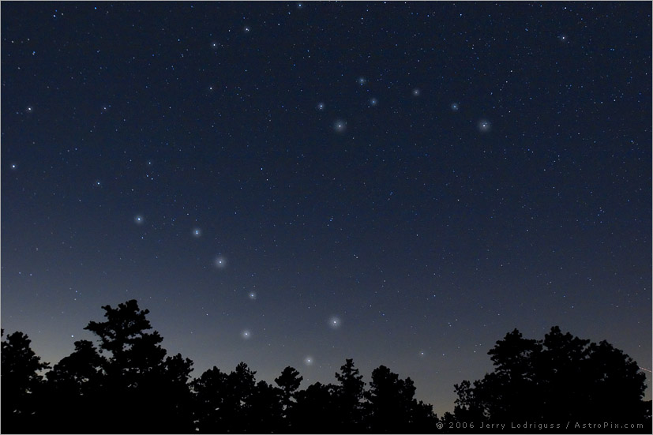
Do you recognize this constellation?
Notes:
he Big Dipper, also known as the "Plough" and the "Drinking Gourd", is an asterism that is part of the constellation of Ursa Major, the Great Bear.
It is a circumpolar constellation, which means it is always above the horizon for observers in most of the United States as it circles around Polaris and the north celestial pole.
The pointer stars in the end of the bowl of the Big Dipper point to Polaris and true north.
In the north –where we are; its up every night all through the year.
Circumpolar :pilgrims, sailors can tell latitude/time so location.
Can tell the time

Slide 36
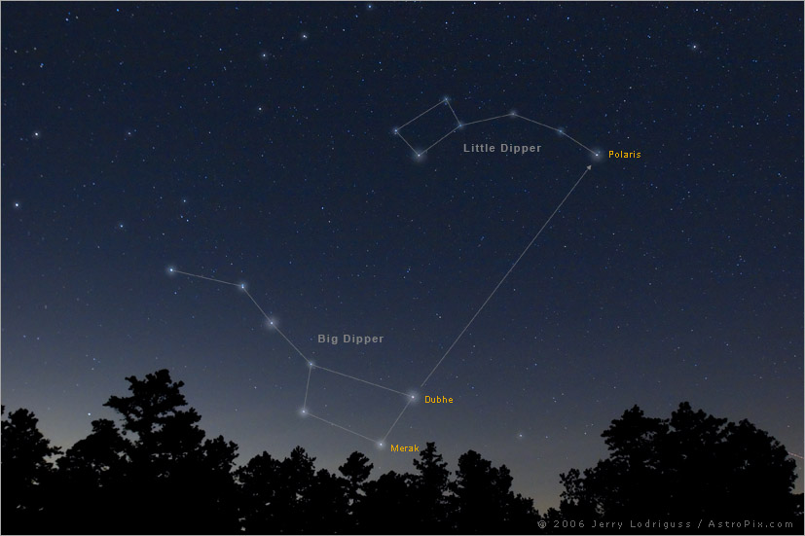
Notes:
he Big Dipper, also known as the "Plough" and the "Drinking Gourd", is an asterism that is part of the constellation of Ursa Major, the Great Bear.
It is a circumpolar constellation, which means it is always above the horizon for observers in most of the United States as it circles around Polaris and the north celestial pole.
The pointer stars in the end of the bowl of the Big Dipper point to Polaris and true north.
In the north –where we are; its up every night all through the year.
Circumpolar :pilgrims, sailors can tell latitude/time so location.
Can tell the time

Slide 37
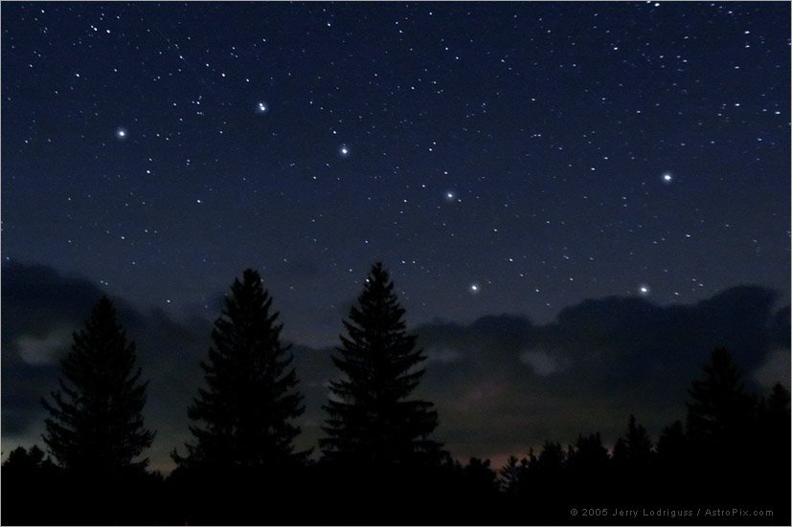
..but what ELSE can we see in the night sky?
Stars
Planets
Notes:
Stars
planets

Slide 38
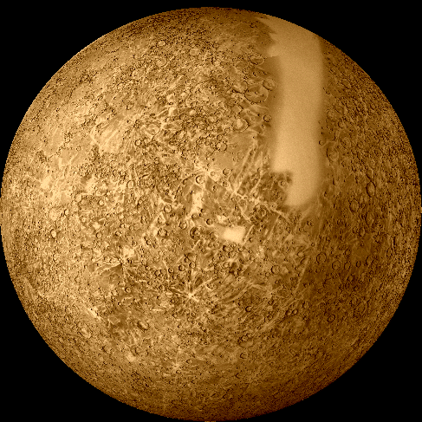
Mercury
Closest to the sun.
Very Hot
Notes:
Mercury from Mariner 10: the only spacecraft to ever visit/pass near the planet in 1974.
Messenger was launched last year and will enter Mercury’s orbit in 2011.
Full of craters ,made up of iron and nickel,weak mag field.
Due to Mercury's rotation and highly elliptical orbit, the Sun appears to rise briefly, set, and rise again before it travels westward across the sky. At sunset, the Sun appears to set, rise again briefly, and then set again. Mercury is only about one-third the size of the Earth. It is smaller than any other planet except Pluto. Mercury is very close to the Sun and has no substantial atmosphere. These factors contribute to the fact that the surface of Mercury has the greatest temperature range of any planet or natural satellite in our solar system. The surface temperature on the side of Mercury closest to the Sun reaches 427 degrees Celsius, a temperature hot enough to melt tin. On the side facing away from the Sun, or the night side, the temperature drops to -183 degrees Celsius. Scientists have detected a magnetic field surrounding Mercury, though it is not as strong as the field around the Earth. Scientists theorize that Mercury's field is due to an iron-bearing core or possibly to the solar winds. Mercury's atmosphere is very thin and is composed of helium and sodium. The surface of Mercury has been shaped by three processes: impact cratering where large objects struck the surface resulting in crater formation, volcanism where lava flooded the surface, and tectonic activity where the planet's crust moved in order to adjust to the planetary cooling and contracting.
Mercury does not have any naturally occurring satellites.
Mercury held at least one major surprise when astronomers studied the planet with radar in 1991. At that time, Mercury's north pole was tilted slightly toward Earth. Astronomers were very surprised to find that north pole area to be "radar bright." These observations suggest ice deposits, strange as that may seem on a world so close to the Sun! But it is possible that the poles may remain cold enough for ice to survive, especially if it was tucked away in a deeper crater.
Another more recent discovery is traces of an atmosphere around Mercury. Granted, it is a very thin tenuous atmosphere, and probably does not really belong to Mercury, but is was a surprise nonetheless! This atmosphere is only a few billionths as dense as Earths, but it is composed of sodium, potassium, hydrogen, helium, oxygen and argon. There is no conceivable way that Mercury's weak gravity could hold onto an atmosphere for long, and so it is believed that this atmosphere is actually captured from the solar wind and therefore constantly replenished.
Planetary scientists have a model for Mercury's formation and history. They believe Mercury has a core much like the Earth's iron core surrounded by crust. Once the core developed, the crust would have expanded, allowing magma to flow up from beneath. As the core cooled, the crust then shrank, wrinkling and forming the scarps so common on Mercury. Solar tides also would have slowed Mercury's rotation.

Slide 39
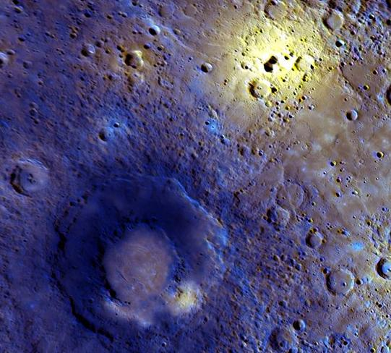
Mercury
Large craters and volcanoes
Notes:
Mercury from Mariner 10: the only spacecraft to ever visit/pass near the planet in 1974.
Messenger was launched last year and will enter Mercury’s orbit in 2011.
Full of craters ,made up of iron and nickel,weak mag field.
Due to Mercury's rotation and highly elliptical orbit, the Sun appears to rise briefly, set, and rise again before it travels westward across the sky. At sunset, the Sun appears to set, rise again briefly, and then set again. Mercury is only about one-third the size of the Earth. It is smaller than any other planet except Pluto. Mercury is very close to the Sun and has no substantial atmosphere. These factors contribute to the fact that the surface of Mercury has the greatest temperature range of any planet or natural satellite in our solar system. The surface temperature on the side of Mercury closest to the Sun reaches 427 degrees Celsius, a temperature hot enough to melt tin. On the side facing away from the Sun, or the night side, the temperature drops to -183 degrees Celsius. Scientists have detected a magnetic field surrounding Mercury, though it is not as strong as the field around the Earth. Scientists theorize that Mercury's field is due to an iron-bearing core or possibly to the solar winds. Mercury's atmosphere is very thin and is composed of helium and sodium. The surface of Mercury has been shaped by three processes: impact cratering where large objects struck the surface resulting in crater formation, volcanism where lava flooded the surface, and tectonic activity where the planet's crust moved in order to adjust to the planetary cooling and contracting.
Mercury does not have any naturally occurring satellites.
Mercury held at least one major surprise when astronomers studied the planet with radar in 1991. At that time, Mercury's north pole was tilted slightly toward Earth. Astronomers were very surprised to find that north pole area to be "radar bright." These observations suggest ice deposits, strange as that may seem on a world so close to the Sun! But it is possible that the poles may remain cold enough for ice to survive, especially if it was tucked away in a deeper crater.
Another more recent discovery is traces of an atmosphere around Mercury. Granted, it is a very thin tenuous atmosphere, and probably does not really belong to Mercury, but is was a surprise nonetheless! This atmosphere is only a few billionths as dense as Earths, but it is composed of sodium, potassium, hydrogen, helium, oxygen and argon. There is no conceivable way that Mercury's weak gravity could hold onto an atmosphere for long, and so it is believed that this atmosphere is actually captured from the solar wind and therefore constantly replenished.
Planetary scientists have a model for Mercury's formation and history. They believe Mercury has a core much like the Earth's iron core surrounded by crust. Once the core developed, the crust would have expanded, allowing magma to flow up from beneath. As the core cooled, the crust then shrank, wrinkling and forming the scarps so common on Mercury. Solar tides also would have slowed Mercury's rotation.

Slide 40
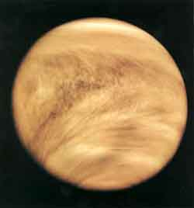
Sister Planet ?
Spins
sdrawkcab
Hot ! Hot! Hot!
        Greenhouse effect?
Notes:
More than 20 spacecraft have visited Venus including Venera 9, which landed on the surface, and Magellan, which used radar to peer through the clouds and make a map of the surface. This visible light picture of Venus was taken by the Galileo spacecraft now in orbit around Jupiter. Many things about Venus remain unknown, including the cause of mysterious bursts of radio waves.
Sun would rise in the west and set in the east
Space probes have revealed that the atmospheric pressure at the surface of Venus is 90 times that of Earth's. This atmosphere consists mainly of carbon dioxide -- the same gas that puts the fizz in soft drinks. It is not breathable. In addition, the clouds of Venus contain drops of sulfuric acid, a poisonous chemical.
More recent radar observations by the Magellan spacecraft have allowed scientists to peek through the clouds and map almost the entire surface of the planet. Magellan discovered mountains on Venus that are higher than any on Earth, as well as a valley that is longer and deeper than the Grand Canyon. It also revealed that the surface of Venus may contain active volcanoes, which occasionally vent molten rock and gas into the hellish atmosphere.
The thick atmosphere on Venus would make it difficult to see objects very far away from you.
Thick, high clouds would make the Sun just a yellow-orange smear of light, if it was visible at all.
Greenhouse effect like a car in the sun for 4 billion year with its windows rolled up!
Venus is referred to as the Evening Star because it is the brightest planet that can be viewed from Earth. Its thick cloud cover is an excellent reflector of the Sun's light.
Venus and Earth are similar in size, composition, and mass. They differ in that Venus does not have oceans or human life, and its temperature during the day reaches 484 degrees Celsius. The daytime temperature is so hot it could melt lead. The dense atmosphere is composed of carbon dioxide and sulfuric acid which acts as a greenhouse and traps the heat. Venus revolves around the Sun in a circular orbit once every 225 Earth days. Venus rotates slowly on its axis in a clockwise direction, which is referred to as a "retrograde" rotation because it is the opposite of the other eight planets. A rotation takes 243 Earth days, so a Venusian day is longer than a Venusian year. As with the other inner planets, the surface of Venus has been shaped by impact craters, tectonic activity, and volcanoes which scientists believe to be ongoing. The volcanic activity is believed to be the source of the sulfur found in the atmosphere. Venus does not have any naturally occurring satellites.
It is the hottest planet, despite being farther from the sun than Mercury, with temperatures reaching more than 400 degrees Celsius. This is most likely due to the amount of greenhouse gases in the atmosphere.

Slide 41
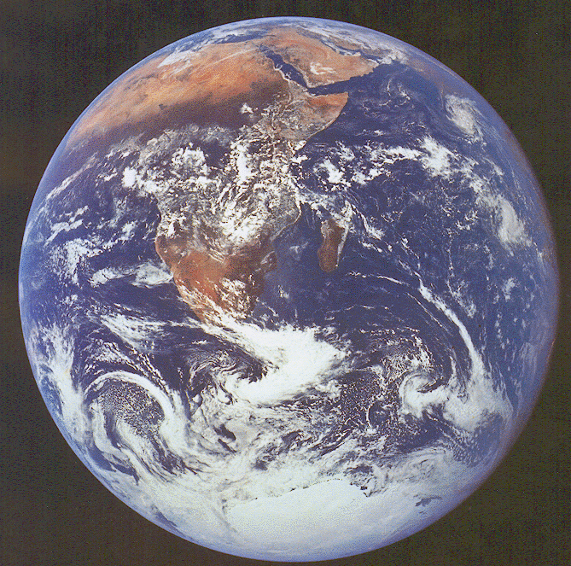
Earth!
Notes:
Wow!
Earth is the only inner planet in our solar system that has liquid water on its surface. Seventy percent of the surface is covered by oceans where photosynthesis takes place. This makes the ocean the principal life habitat on Earth.
Earth's amazing gaseous atmosphere is responsible for making life possible on this, the third planet from the Sun. Our atmosphere contains water vapor which helps to moderate our daily temperatures. Our atmosphere contains 21% oxygen, which is necessary for us to breathe, 78% nitrogen, and .9% argon. The other 0.1% consists of water vapor, carbon dioxide, neon, methane, krypton, helium, xenon, hydrogen, nitrous oxide, carbon monoxide, nitrogen dioxide, sulfur dioxide, and ozone. These latter elements are important to have because they help to absorb harmful solar radiation before it can reach the surface of the Earth. If present in larger amounts, most of these latter elements would be poisonous to humans. The atmosphere protects us from meteors as well. Due to the friction generated between a meteor and the atmospheric gases, most meteors burn up before hitting Earth's surface as a meteorite.
TEarth rotates on an imaginary axis which is tilted at a 23.5 degree angle. The rotation is what causes the change from day to night. The tilt is what determines our change in seasons. If the Earth was not tilted, we would have the same season all year long. Earth has a core of molten iron-nickel. The rapid spin of the Earth along with the liquid, hot metallic core causes a magnetic field to surround the Earth. This magnetic field traps the charged particles which are hurled at the Earth by the Sun during solar wind activity. When these charged particles react with the gases in our atmosphere, the gases begin to glow. These aurorae, or glowing gases, are seen in the Arctic Circle and the Antarctic Circle. As with all inner planets, Earth's surface has been affected by volcanism, tectonic activity, and to a lesser degree, meteorite impacts. Earth has one naturally occurring satellite, the Moon.

Slide 42
Apollo 11, 1969
“One small step for a man, but a giant leap for Mankind ”
Notes:
Explanation: Bright sunlight glints and long dark shadows dramatize this image of the lunar surface taken by Apollo 11 astronaut Neil Armstrong, the first to walk on the Moon. Pictured is the mission's lunar module, the Eagle, and spacesuited lunar module pilot Buzz Aldrin unfurling a long sheet of foil also known as the Solar Wind Collector. Exposed facing the Sun, the foil trapped atoms streaming outward in the solar wind, ultimately catching a sample of material from the Sun itself. Along with moon rocks and lunar soil samples, the solar wind collector was returned for analysis in earthbound laboratories.
Where

Slide 43
Apollo 17, 1972
Notes:
In December of 1972, Apollo 17 astronauts Eugene Cernan and Harrison Schmitt spent about 75 hours on the Moon, in the Taurus-Littrow valley, while colleague Ronald Evans orbited overhead. Near the beginning of their third and final excursion across the lunar surface, Schmitt took this picture of Cernan flanked by an American flag and their lunar rover's umbrella-shaped high-gain antenna. The prominent Sculptured Hills lie in the background while Schmitt's reflection can just be made out in Cernan's helmet. The Apollo 17 crew returned with 110 kilograms of rock and soil samples, more than from any of the other lunar landing sites. And after thirty years, Cernan and Schmitt are still the last to walk on the Moon.

Slide 44
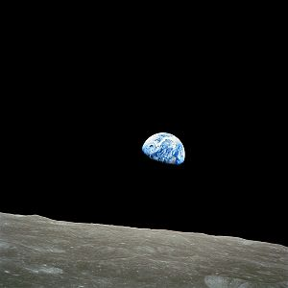
Apollo 8, 1968
Earthrise ??
Notes:
Does this remind you of any particular phase of the the moon?
Why does the moon have phases?
Are there earth phases on the moon?
When the moon is at third quarter, the earth would be at first quarter. When the moon is full, the earth would be at "new earth" phase and vice versa.
If you stood on the moon, you could see the sun rise and set. But you wouldn’t see sunrise or sunset as often as we do on Earth.
The moon takes 28 days to rotate about its axis! So one day on the the moon is 1 earth month. So you would see a sunrise every 29 days.

Slide 45
Earth??
Or Mars??
Notes:
Which image is Earth, and which is Mars? One of the above images was taken by the robot Spirit rover currently climbing Husband Hill on Mars. The other image was taken by a human across the desert south of Morocco on Earth. Both images show vast plains covered with rocks and sand. Neither shows water or obvious signs of life. Each planet has a surface so complex that any one image does not do that planet justice. Understanding either one, it turns out, helps understand the other. Does the one on the left look like home? Possibly not, but it is Earth.

Slide 46
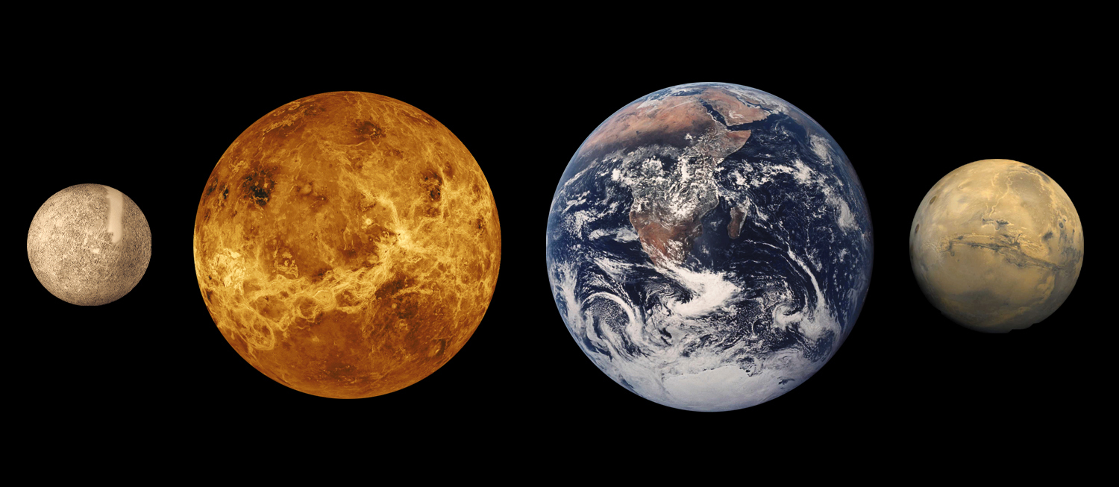
Inner Planets
Notes:
The four inner or terrestrial planets are characterised by their dense, rocky composition, few or no moons, and lack of ring systems. They are composed largely of minerals with high melting points such as silicates to form the planets' solid crusts and semi-liquid mantles, and metallic dust grains such as iron, which forms their cores. Three of the four inner planets have atmospheres. All have impact craters, and all but one possess tectonic surface features, such as rift valleys and volcanoes. The term inner planet should not be confused with inferior planet, which designates those planets which are closer to the Sun than the Earth is (i.e. Mercury and Venus).
The four inner planets are:

Slide 47
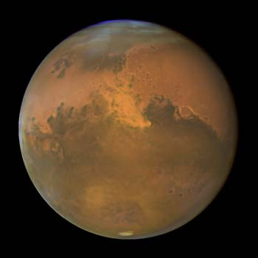
What is the color of this planet?
Dust Storm on Mars
Notes:
NASA's Hubble Space Telescope snapped this picture of Mars on October 28, within a day of its closest approach to Earth on the night of October 29. Hubble astronomers were also excited to have captured a regional dust storm on Mars that has been growing and evolving over the past few weeks.
The dust storm, which is nearly in the middle of the planet in this Hubble view is about 930 miles (1500 km) long measured diagonally, which is about the size of the states of Texas, Oklahoma, and New Mexico combined. No wonder amateur astronomers with even modest-sized telescopes have been able to keep an eye on this storm. The smallest resolvable features in the image (small craters and wind streaks) are the size of a large city, about 12 miles (20 km) across. The occurrence of the dust storm is in close proximity to the NASA Mars Exploration Rover Opportunity's landing site in Sinus Meridiani. Dust in the atmosphere could block some of the sunlight needed to keep the rover operating at full power.
On October 29/30, Mars and Earth reached the point in their orbits where the two planets were the closest they have been since August of 2003. The red planet, named after the Roman god of war, won't be this close again to Earth until 2018. At the 2005 closest approach Mars was at a distance of 43 million miles (69 million km), comparatively a stone's throw across the solar system. Mars goes through a 26-month cycle where its distance from Earth changes. At times when the distance is smallest between the two planets, Mars appears brighter in the sky and larger through telescopes for Earth viewers.
This image of 2005 Mars closest approach was taken with Hubble's Advanced Camera for Surveys. Different filters show blue, green, and red (250, 502 and 658 nanometer wavelengths). North is at the top of the image. Mars is now in its warmest months, closest to the Sun in its orbit, resulting in a smaller than normal south polar ice cap which has largely sublimated with the approaching summer.
The large regional dust storm appears as the brighter, redder cloudy region in the middle of the planet's disk. This storm has been churning in the planet's equatorial regions for several weeks now, and it is likely responsible for the reddish, dusty haze and other dust clouds seen across this hemisphere of the planet in views from Hubble, ground based telescopes, and the NASA and ESA spacecraft studying Mars from orbit. Bluish water-ice clouds can also be seen along the limbs and in the north (winter) polar region at the top of the image

Slide 48
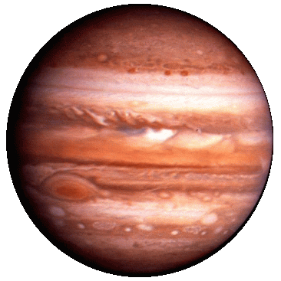
Jupiter
Jupiter

Slide 49
Lord of the rings
“Lord of the Rings”
Notes:
Above is a Hubble Picture. the rings are perhaps only a hundred million years young. Accumulating dust and dynamically interacting with Saturn's moons, the rings may eventually darken and sag toward the gas giant, losing their lustre over the next few hundred million years.
Although the cloud features on Saturn are not as striking as those on Jupiter, they do change. Winds caused by Saturn's rotation stretch the clouds into horizontal bands circling the planet. At the equator, these winds reach speeds of 1,100 miles (1,770 km) per hour.
Saturn is a large gas planet with an atmosphere composed of hydrogen and helium. Saturn's rapid spin tends to flatten out the poles while causing a bulge at its equator. The winds in Saturn's atmosphere reach speeds up to 1800 kilometers per hour! Astronomers see large white spots (or clouds) on Saturn which they believe are storms. Just like Jupiter, Saturn emits twice as much heat as it absorbs from the Sun indicating it also has an internal heat source. Saturn has an extensive ring system which is formed by a thousand individual rings. The rings appear to contain water ice and dust. The thickness of the rings ranges from 10 to 100 meters and the rings vary in brightness. There are gaps between some rings, while other rings appear to be braided together. Astronomers believe the rings developed from particles that resulted from the break-up of naturally occurring satellites. The particles in the rings closer to the planet orbit the planet at a faster speed than the particles in the rings farther from the planet. There are satellites within the rings which result in the gaps that are present between some rings. As with Jupiter, the pressurized hydrogen in Saturn's mantle produces electric currents which create a strong magnetic field around the planet. Saturn has at least 30 naturally occurring satellites.

Slide 50
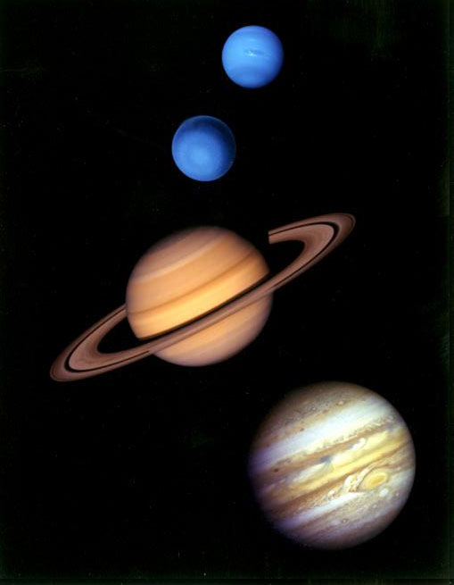
The Jovian
Gas Planets

Slide 51
Tonight you should be able to see:
So go out and explore
the night sky!!
the moon!!
all five of the planets visible
without a telescope!!
the big dipper and orion
Notes:
½ moon
Look west after sunset..see mercury right behind the sun, then venus, jupiter.straight line from jupiter and venus to mercury.
Look east see mars rising in the east around the same time , and10:30 -11:00 see satun rising.

Slide 53
Before August 24th, 2006.
Notes:
The planets and their relative sizes. Use this slide to talk about their shape…are they squares??
Tell them todays talk is about the solar system
Yes, Planets seem to be spheres, not cubes or cylinders or oddball rocky shapes. Some smaller bodies such as asteroids or Mars moons Phobos and Deimos, do have odd shapes, but larger bodies like the nine planets and most of their moons do look like spheres. That's because of the nature of gravity. You can think of gravity as a force that points inward toward the center of the planet so that every part of the surface is pulled evenly toward the center, resulting in a spherical shape. Of course, planets are not perfect spheres because mountains and valleys and even skyscrapers are all deviations from the spherical shape. However, as planets get larger, gravity gets stronger, until eventually large objects on the surface are crushed under their own weight. That's why we don't have mountains that are 50 miles high or skyscrapers that are 2,000 stories tall. Planets stay basically spherical because any large deviations get crushed.
Although gravity keeps planets close to spherical, there are other forces that cause deviations from the basic spherical shape. For example, the rotation of the earth once every 24 hours, causes an apparent centrifugal force which creates a bulge at the equator. In fact the earth's diameter at the equator is 7,926 miles while the diameter between the poles is only 7,900.
What do you think is the shape of stars??
Pointed like we draw them??
Planets are not perfectly spherical because they also spin. The spinning force acts against gravity and causes many planets to bulge out more around their equators.
.

Slide 54

After August 24th, 2006 !
Notes:
Whats a planet anyway???
Here's how it all shakes out. The International Astronomical Union has decided that, to be called a planet, an object must have three traits. It must orbit the sun, be massive enough that its own gravity pulls it into a nearly round shape, and be dominant enough to clear away objects in its neighborhood.
To be admitted to the dwarf planet category, an object must have only two of those traits -- it must orbit the sun and have a nearly round shape. And no, moons don't count as dwarf planets. In addition to Pluto, Ceres and 2003 UB313, the astronomical union has a dozen potential dwarf planets on its watchlist.
What's to become of the other objects in our solar system neighborhood, the ones that are not planets, not dwarf planets and not moons? The organization has decided that most asteroids, comets and other small objects will be called "small solar-system bodies

Slide 55
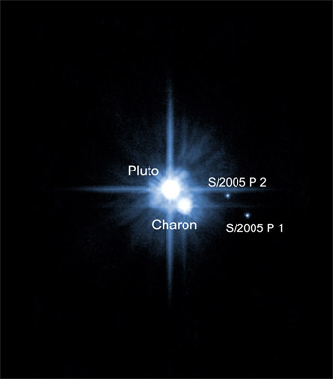

Slide 56
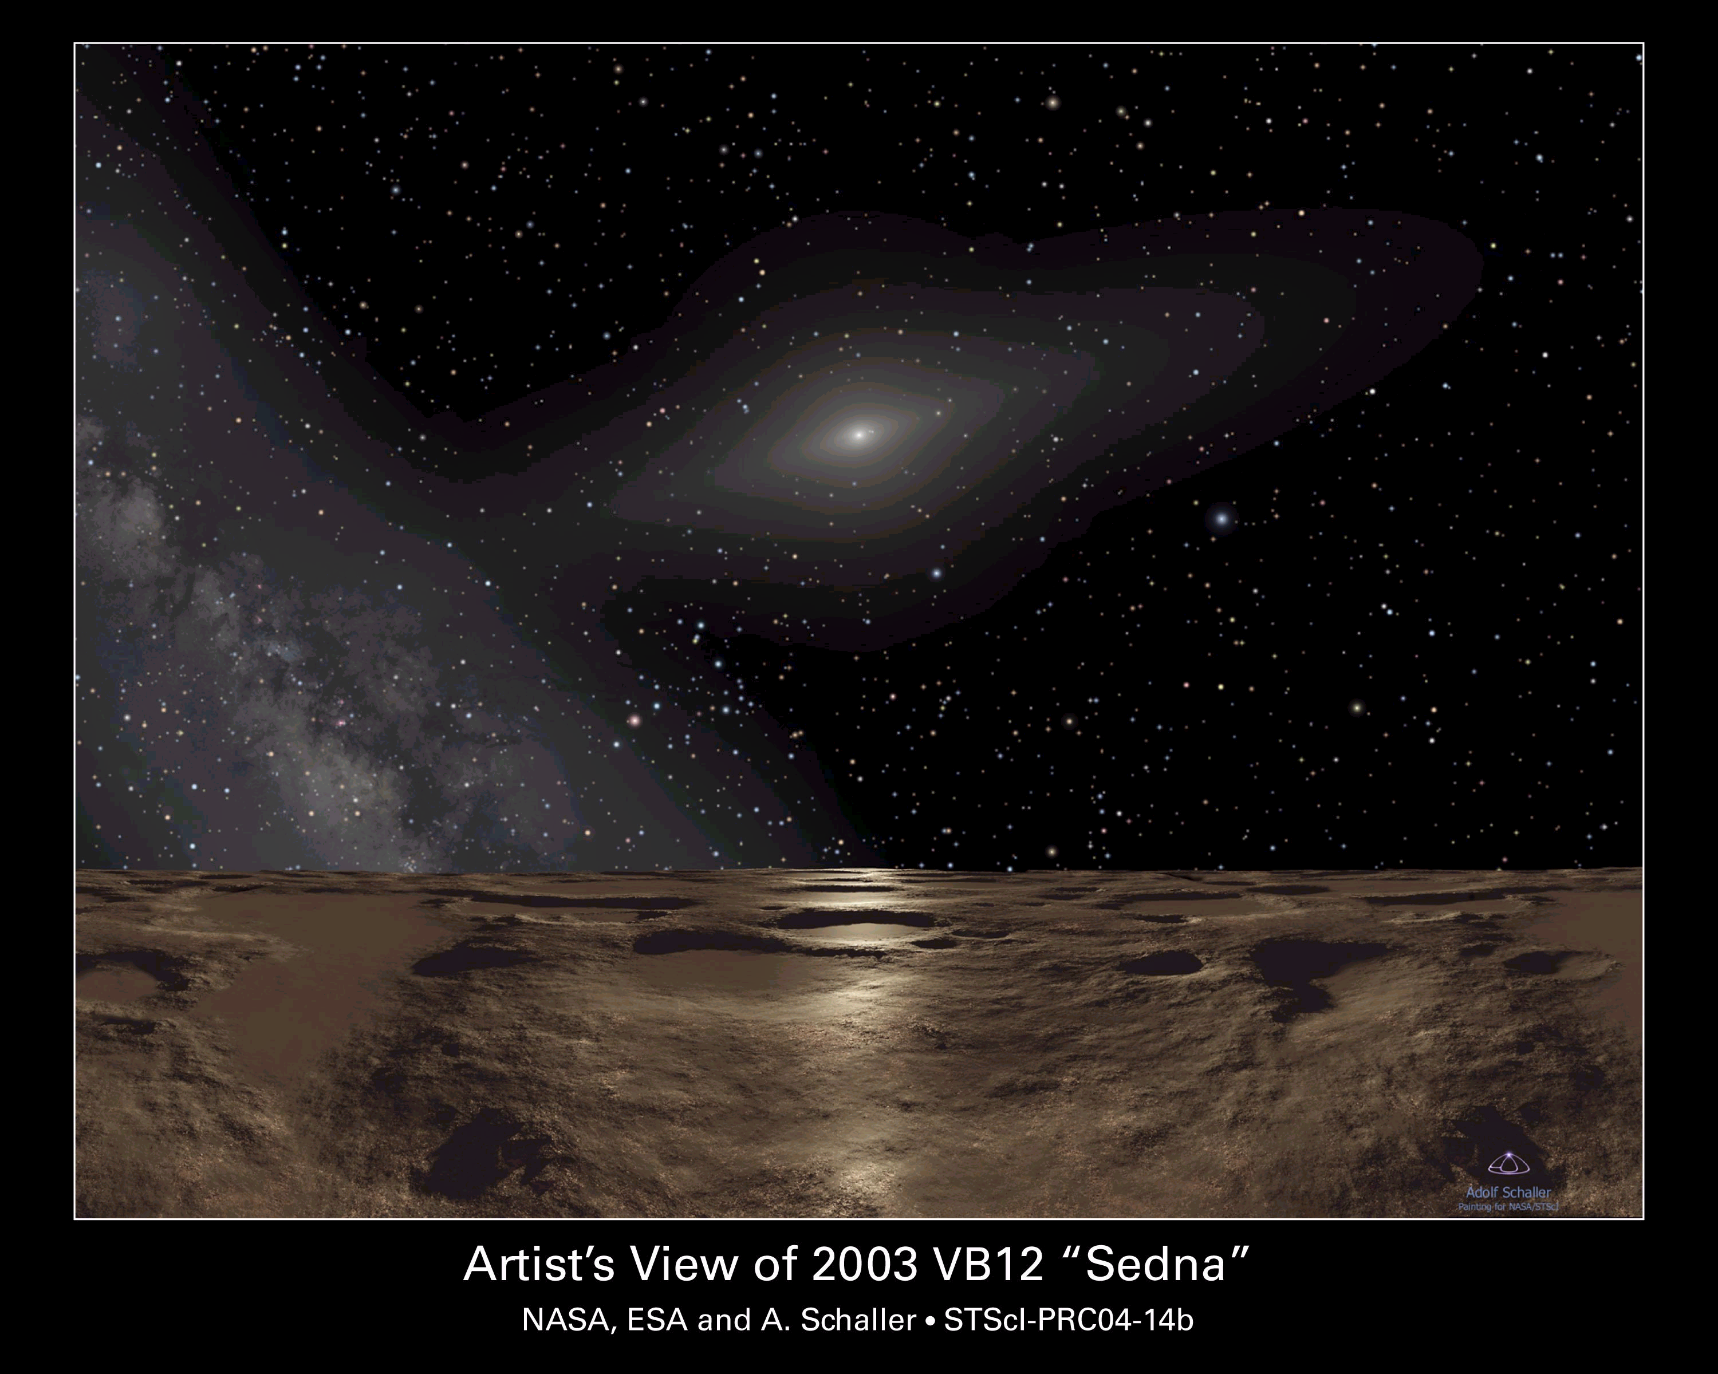
Noon on Sedna !
Notes:
Sedna at noon

Slide 62
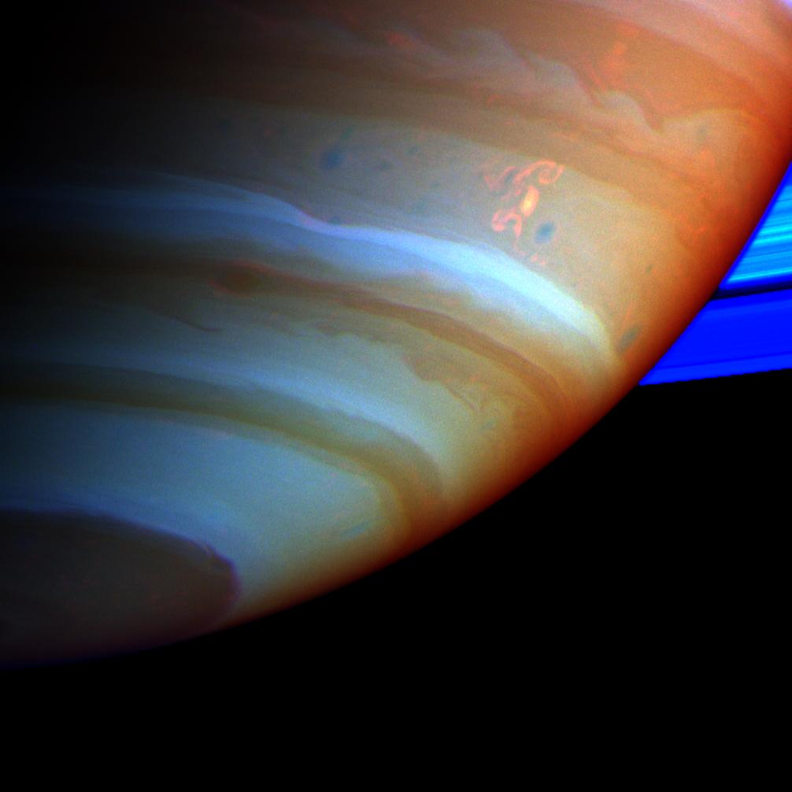
Storms and Seasons on Saturn?
Saturn’s axis is tilted
Each season is 7 years long
The “Dragon Storm”
Float in the bathtub!!
Notes:
The white wisp shown on Saturn's cloud tops is actually a major storm system only discovered in December of 1994. Saturn's clouds are composed of primarily hydrogen and helium, but the storm's white clouds are actually ammonia ice crystals that have frozen upon upheaval to the top of the atmosphere. The storm may look small but has an extent similar to the diameter of the Earth. This picture is a color composite of several taken by the Hubble Space Telescope. Saturn is the second largest planet in the Solar System and has the most elaborate ring system.
Gap in the rings is called the Cassini Division.
Rings are not solid they are composed of ice chunks which range in size from a grain of sand to a house.
Two of its 49 moons, Titan and Enceladus, show signs of geological activity, though they are largely made of ice. Titan, like Ganymede, is larger than Mercury; it is also the only satellite in the solar system with a substantial atmosphere, similar in composition to that of the atmosphere of the early Earth.

Slide 63
Uranus
Notes:
Uranus is unique in our solar system because it is tilted 98 degrees. When viewed from Earth, it appears to rotate on its side! At different times throughout its orbit, we can actually view one of the planet's poles head-on. The atmosphere is composed of hydrogen, helium, and methane. The temperature in the upper atmosphere is so cold that the methane condenses and forms a thin cloud layer which gives the planet its blue-green appearance. The winds on Uranus blow mainly to the east and can reach speeds up to 600 kilometers per hour. The rapid spin of Uranus influences the winds in the atmosphere. Uranus has a very strong magnetic field. This planet has a system of rings which was not discovered until 1977. The ring system contains eleven dark rings composed of varying sized particles. Satellites embedded in the rings create gaps between the rings. Uranus has 21 known natural satellites (and may have at least 27), both within the rings and outside of the rings.
Uranus (19.6 AU) at 14 Earth masses, is the lightest of the outer planets. Uniquely among the planets, it orbits the Sun on its side; its axial tilt lies at over ninety degrees to the ecliptic. Its core is remarkably cold (compared with the other gas giants; it is still several thousand degrees Celsius) and radiates very little heat into space. Uranus has 27 satellites, the largest being Titania, Oberon, Umbriel, Ariel and Miranda.

Slide 64
Neptune
Neptune
Notes:
Photograph taken by voyager:
Neptune (30 AU), though slightly smaller than Uranus, it is denser and slightly more massive, at 17 Earth masses, and radiates more internal heat than Uranus, but not as much as Jupiter or Saturn. Its peculiar ring system is composed of a number of dense "arcs" of material separated by gaps. Neptune has 13 moons. The largest, Triton, is geologically active, with geysers of liquid nitrogen, and is the only large satellite to revolve around its host planet in a prograde (clockwise) motion.

Slide 65
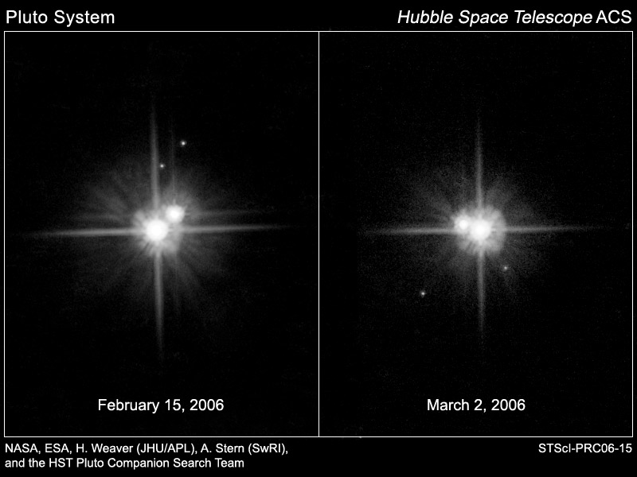
What happened to Pluto?
Notes:
The International Astronomical Union (IAU), the official scientific body for astronomical nomenclature, currently defines "dwarf planet" as a celestial body that, within the Solar System,^{[1]}
(a) is in orbit around the Sun;
(b) has sufficient mass for its self-gravity to overcome rigid body forces so that it assumes a hydrostatic equilibrium (nearly round) shape;
(c) has not cleared the neighbourhood around its orbit; and
(d) is not a satellite
At current, the term only applies to our solar system.^{[2]}
The IAU's stance on dwarf planets within our solar system has been formally adopted by the IAU general assembly (in 2006). It differs from the definition of "planet" in that the dwarf planet has not cleared its orbital neighbourhood. Before the adoption of the 2006 resolution, there was no formally specified scientific definition of "dwarf planet". The category is distinguished from "planets" and "small solar system bodies".
Under the IAU's definition, our solar system is considered to have three dwarf planets: Ceres (the smallest), Pluto and Eris (the largest). However, many more objects could be added to the list once it has
Due to their similarity in size, Pluto and its satellite Charon are considered to be a double planet
For 28 years, Charon was the only known moon orbiting the planet Pluto. Now, Charon has company. A recent Hubble Space Telescope observation has revealed two new moons orbiting Pluto, the smallest planet in the solar system.
Where is the Kuiper Belt?
SEE MORE
Pluto is farther from the Sun than any of the planets. It resides in a region of space called the Kuiper (pronounced “ki-per”) Belt. Scientists believe many comets occupy the Kuiper Belt.
Hubble peeks at Pluto in 1996
ENLARGE
Pluto, 1996: The planet's best portrait
Little is known about the makeup of this tiny planet. In 1996, the Hubble Space Telescope observed Pluto. The pictures revealed that Pluto’s surface is more complex than scientists had imagined, with large-scale features, including icy-bright polar caps.
Pluto is the only planet in the solar system that has not been visited by a spacecraft. In January 2006, NASA launched the New Horizons mission to Pluto and the Kuiper Belt, but it will take more than nine years for the spacecraft to arrive at its targets.
Pluto moon hunt in 2005
ENLARGE
Pluto, 2005:
Possible new
moons
In anticipation of the New Horizons mission, astronomers used the Hubble telescope in May 2005 to hunt for moons in Pluto’s vast outer region. Many other telescopes had studied the region close to Pluto, but none had found anything interesting. To the surprise of astronomers, the Hubble snapshots revealed two objects close to Pluto that had never before been noticed.
The newly-discovered objects were much smaller than Charon. Charon is about half Pluto’s size. The two new objects were about twice as far away from Pluto as Charon, but still close to the planet.
A second image of Pluto taken three days later showed the objects in the same area. Scientists thought the objects were two new moons. However, they had to confirm that the objects really were moons and not just icy rocks from the Kuiper Belt that were passing by Pluto. Before a new moon can be validated, astronomers must establish its orbit, or path around the planet, by making another observation.
Findings confirmed
ENLARGE
Pluto, 2006:
Hubble Space Telescope confirms two new moons
for Pluto
Scientists used the Hubble telescope in February 2006 to search again for these suspected moons — and found them. Finding the moons in the positions predicted from their orbits meant they are valid moons.
Where did they come from?
It was possible that the two new moons were icy rocks from the Kuiper Belt that had been “captured” by Pluto — attracted into orbit by Pluto’s gravity. However, scientists discovered that the new moons and the “old” moon, Charon, orbit Pluto in the same way. From this information, astronomers think all three moons formed at the same time as Pluto.
The confirmation of the new moons makes Pluto the first Kuiper Belt resident known to have more than one moon.

Slide 66
Mars Plates
Notes:
What are those unusual plates on Mars? A leading current interpretation holds that they are blocks of ice floating on a recently frozen sea covered by dust. The unusual plates were photographed recently by the European Space Agency's Mars Express spacecraft currently orbiting Mars. Oddly, the region lies near the Martian equator and not near either of Mars' frozen polar caps. Without being covered by dust, any water or ice near away from the poles would quickly evaporate right into the atmosphere. Evidence that the above-imaged plates really are dust-covered water-ice includes a similarity in appearance to ice blocks off Earth's Antarctica, nearby surface fractures from which underground water could have flowed, and the shallow depth of the craters indicating that something is filling them in. If correct, the low abundance of craters indicates that water may have flowed on Mars as recently as five million years ago.
Mounting evidence that Ancient Mars was wet

